Slide 1
Uterus

Slide 2
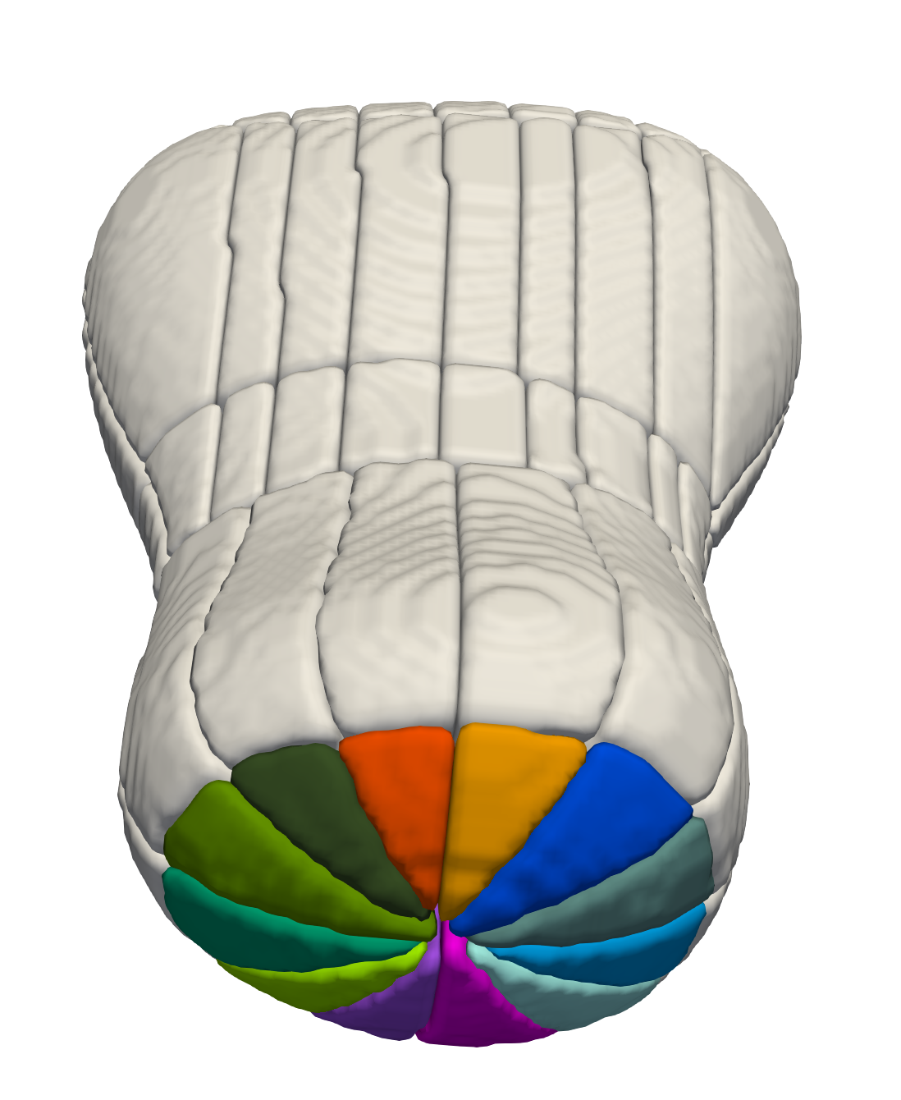
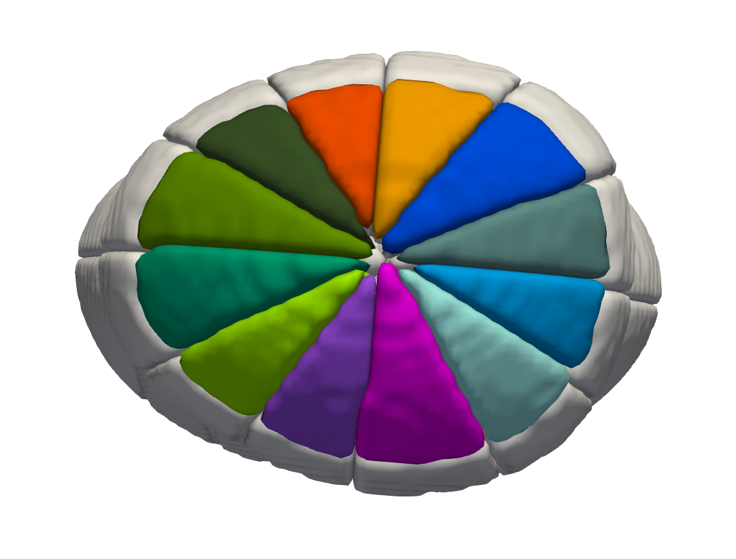
Uterus – Cervix – Ectocervix (#1 – 12)
ANTERIOR
PATIENT RIGHT
PATIENT LEFT
#12 11 o’clock – 12 o’clock
#1 12 o’clock – 1 o’clock
#11 10 o’clock – 11 o’clock
#2 1 o’clock – 2 o’clock
#10 9 o’clock – 10 o’clock
#3 2 o’clock – 3 o’clock
#9 8 o’clock – 9 o’clock
#4 3 o’clock – 4 o’clock
#8 7 o’clock – 8 o’clock
#5 4 o’clock – 5 o’clock
#7 6 o’clock – 7 o’clock
#6 5 o’clock – 6 o’clock

Slide 3
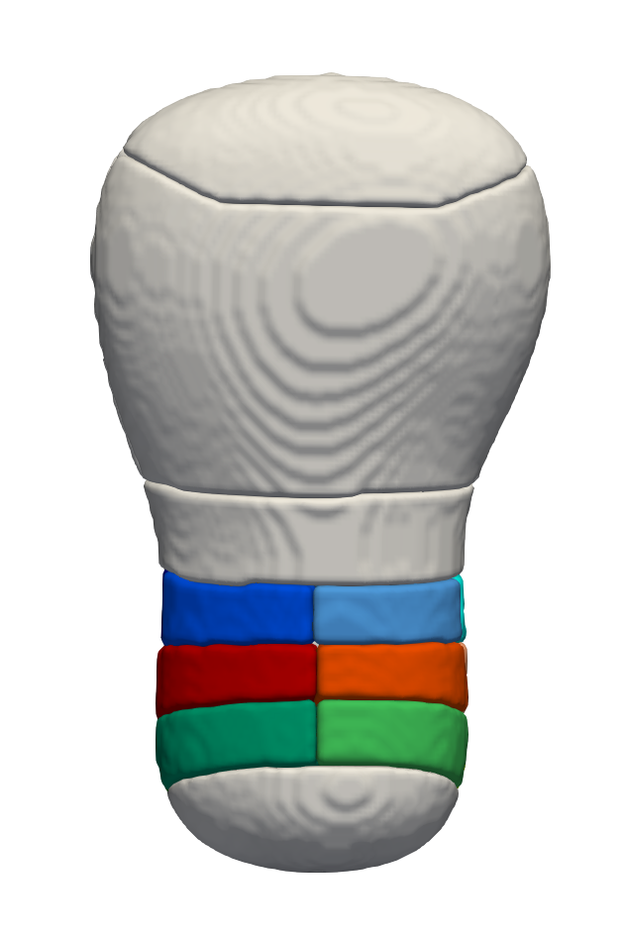
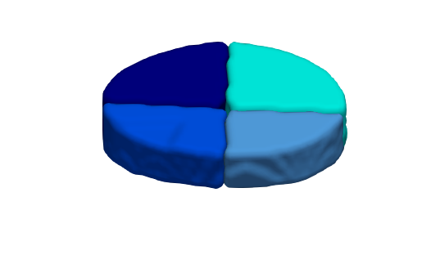
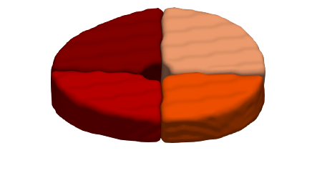
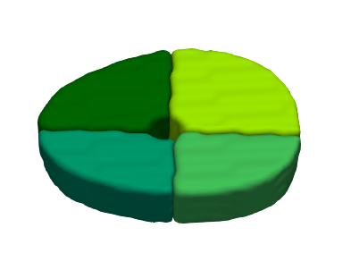
Uterus – Cervix – Endocervix (#13 – 24)
PATIENT RIGHT
PATIENT LEFT
fundus
#24 Slice 3: 9 o’clock – 12 o’clock
#21 Slice 3: 12 o’clock – 3 o’clock
body
#23 Slice 3: 6 o’clock – 9 o’clock
#22 Slice 3: 3 o’clock – 6 o’clock
lower uterine segment
#20 Slice 2: 9 o’clock – 12 o’clock
#17 Slice 2: 12 o’clock – 3 o’clock
endocervix
#19 Slice 2: 6 o’clock – 9 o’clock
#18 Slice 2: 3 o’clock – 6 o’clock
ectocervix
#16 Slice 1: 9 o’clock – 12 o’clock
#13 Slice 1: 12 o’clock – 3 o’clock
ANTERIOR VIEW
#15 Slice 1: 6 o’clock – 9 o’clock
#14 Slice 1: 3 o’clock – 6 o’clock

Slide 4
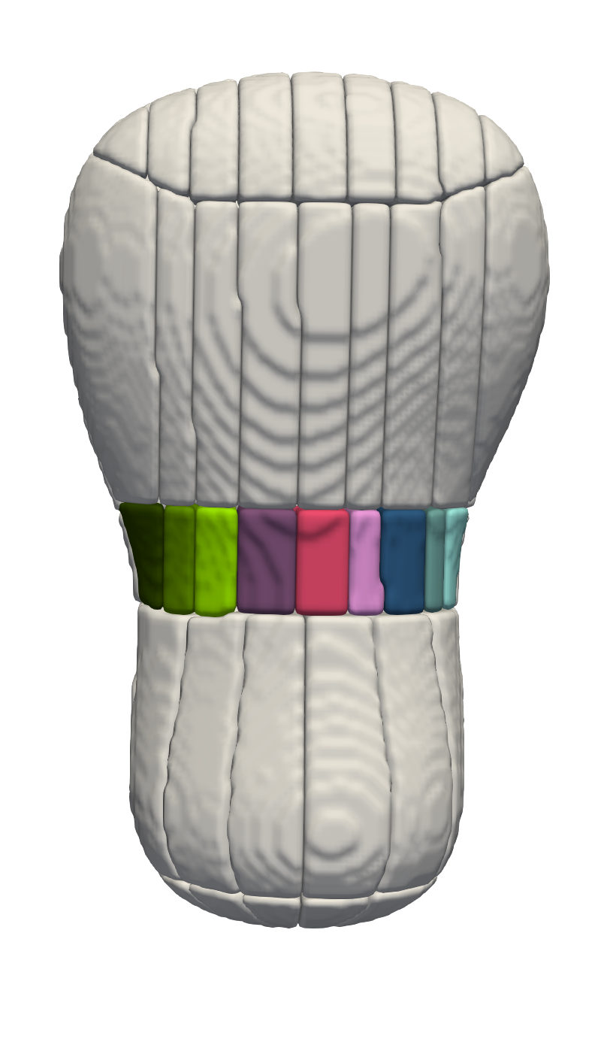
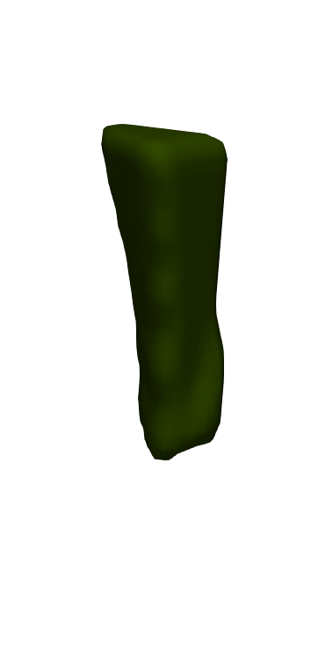
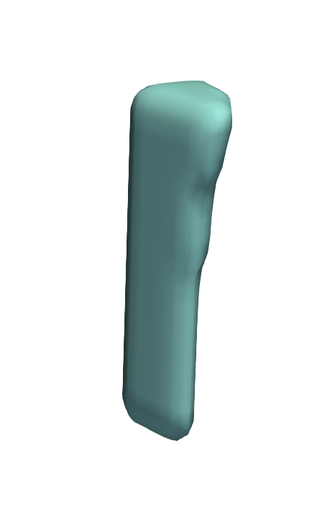
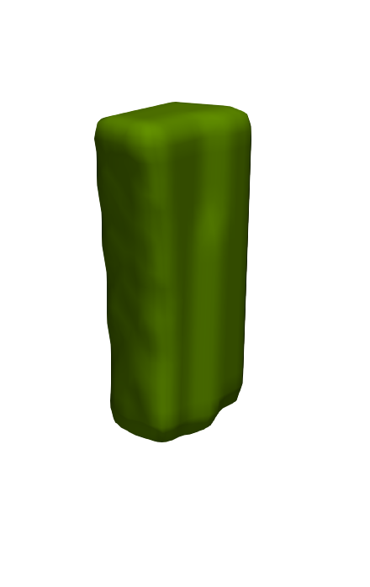
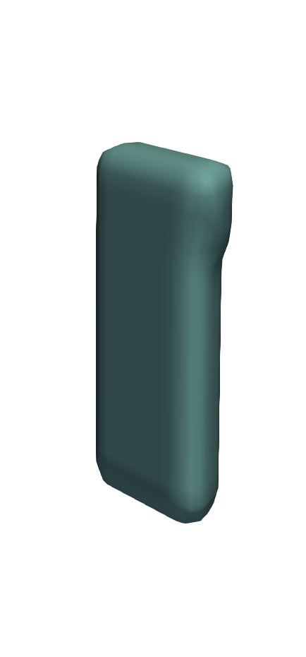
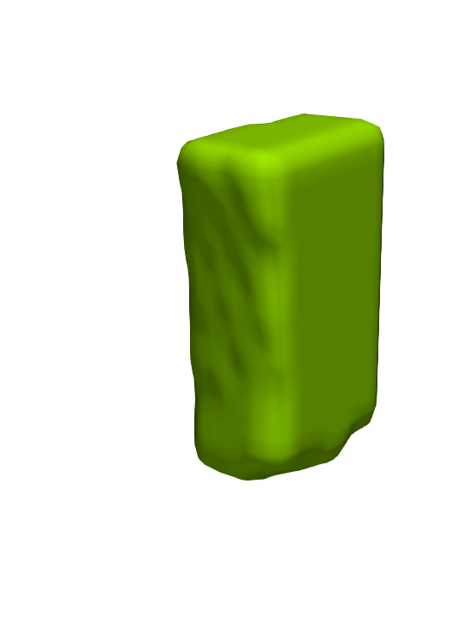
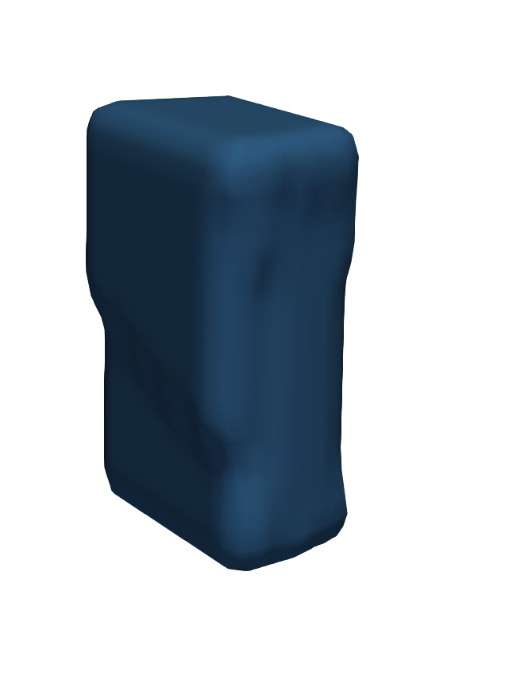
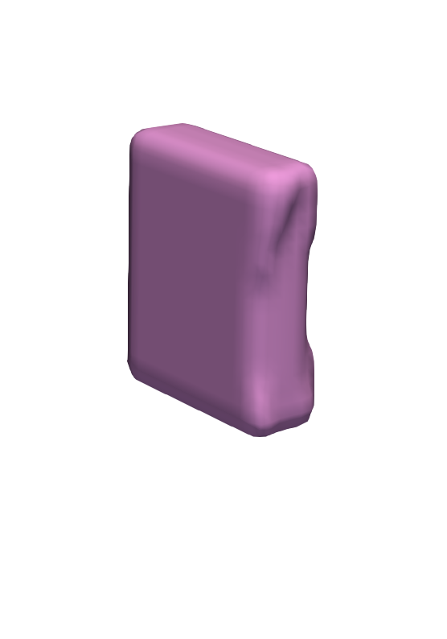


Uterus – Anterior - Lower Uterine Segment (#25 – 42)
ANTERIOR VIEW
PATIENT RIGHT
PATIENT LEFT
#42 Slice 3 – myometrium & endometrium
#26 Slice 1 – myometrium & endometrium
#40 Slice 2 – myometrium & endometrium
#28 Slice 2 – myometrium & endometrium
#41 Slice 3 – serosa & myometrium
#38 Slice 1 – myometrium & endometrium
#30 Slice 3 – myometrium & endometrium
#25 Slice 1 – serosa & myometrium
Right
Central
Left
#39 Slice 2 – serosa & myometrium
#27 Slice 2 – serosa & myometrium
#37 Slice 1 – serosa & myometrium
#36 Slice 3 – myometrium & endometrium
#32 Slice 1 – myometrium & endometrium
#34 Slice 2 – myometrium & endometrium
#29 Slice 3 – serosa & myometrium
#35 Slice 3 – serosa & myometrium
#31 Slice 1 – serosa & myometrium
#33 Slice 2 – serosa & myometrium

Slide 5
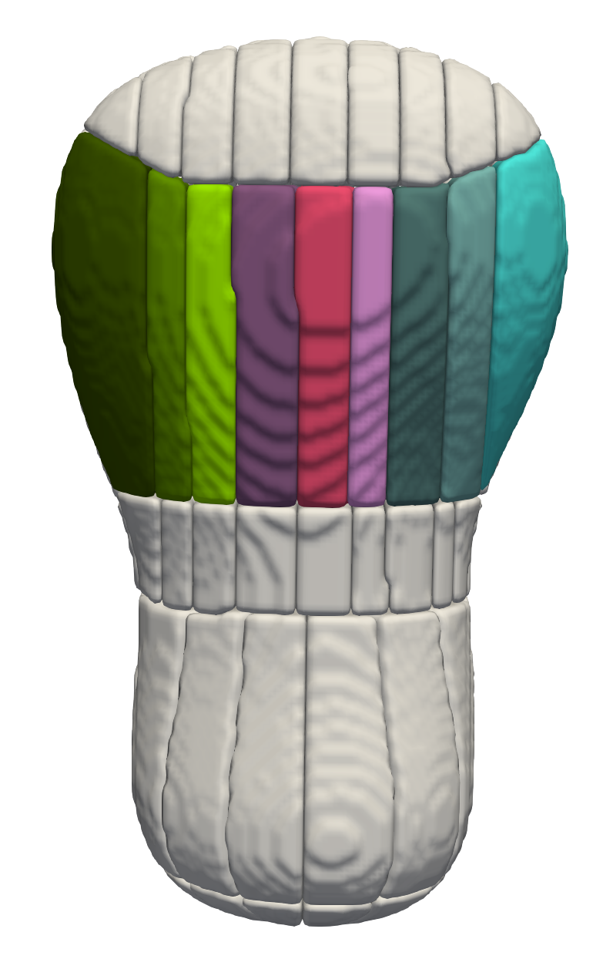
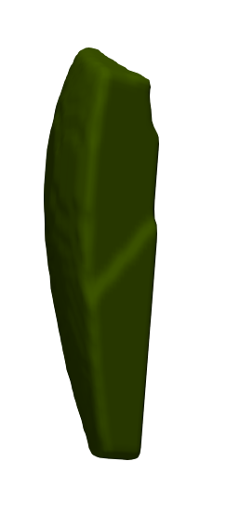
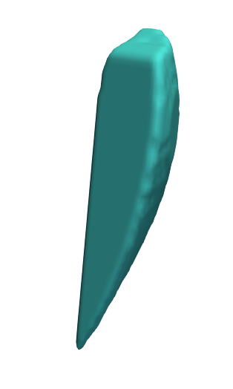
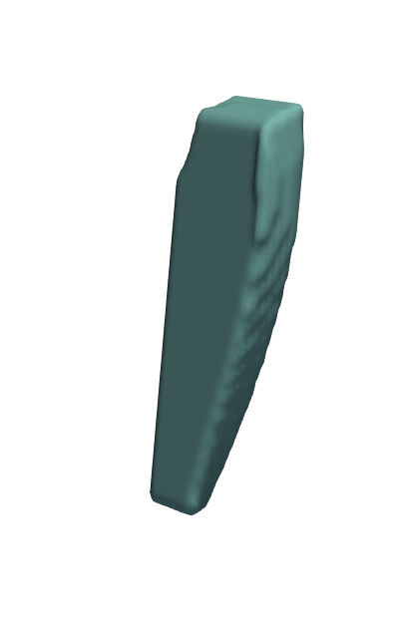
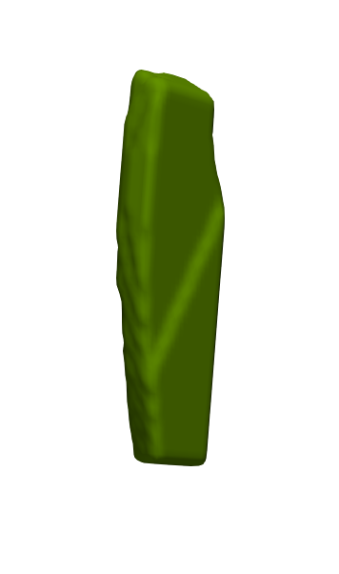
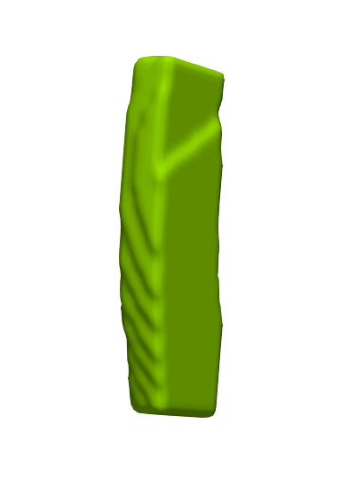
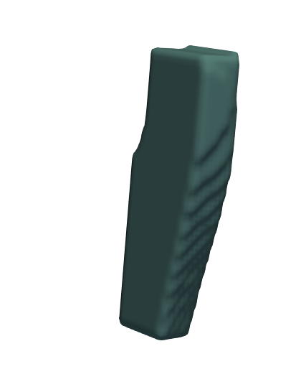
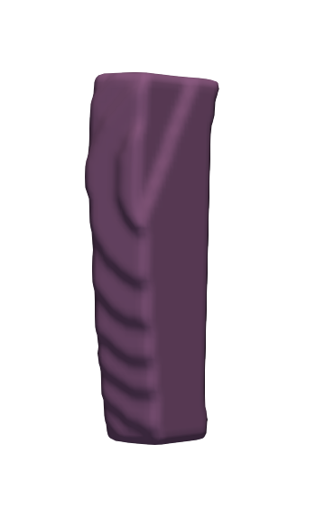
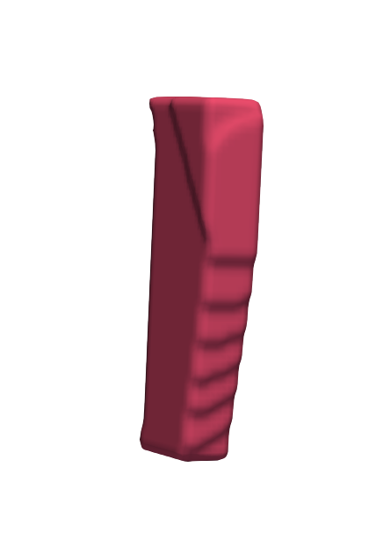
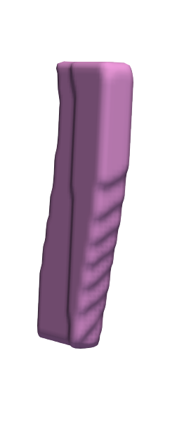
Uterus – Anterior – Body (#43 - 60)
ANTERIOR VIEW
PATIENT RIGHT
PATIENT LEFT
#60 Slice 3 – myometrium & endometrium
#44 Slice 1 – myometrium & endometrium
#58 Slice 2 – myometrium & endometrium
#46 Slice 2 – myometrium & endometrium
#56 Slice 1 – myometrium & endometrium
Central
#59 Slice 3 – serosa & myometrium
Right
Left
#48 Slice 3 – myometrium & endometrium
#43 Slice 1 – serosa & myometrium
#57 Slice 2 – serosa & myometrium
#45 Slice 2 – serosa & myometrium
#55 Slice 1 – serosa & myometrium
#54 Slice 3 – myometrium & endometrium
#52 Slice 2 – myometrium & endometrium
#50 Slice 1 – myometrium & endometrium
#47 Slice 3 – serosa & myometrium
#53 Slice 3 – serosa & myometrium
#49 Slice 1 – serosa & myometriumv
#51 Slice 2 – serosa & myometrium

Slide 6
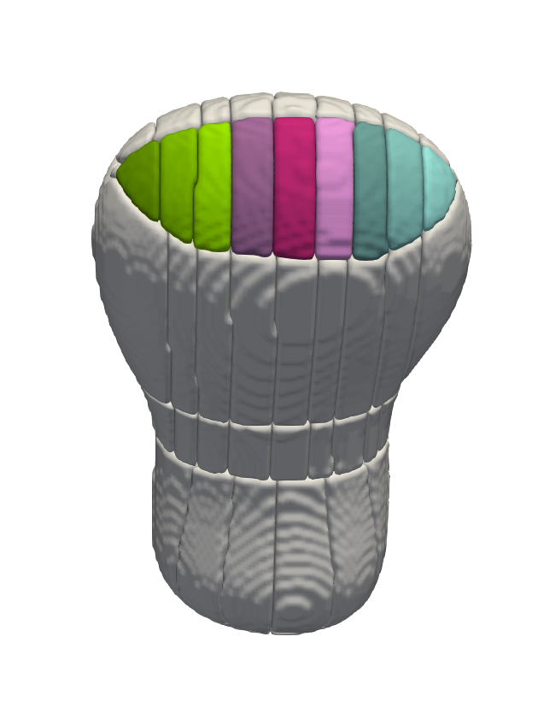
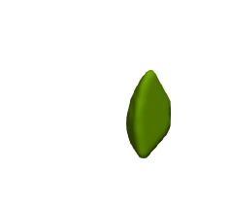
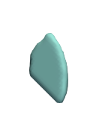
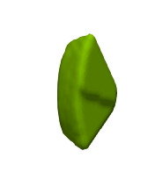
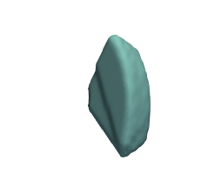
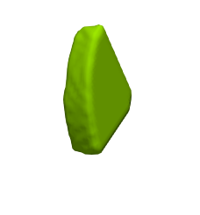
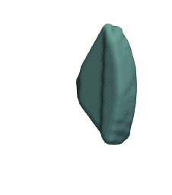
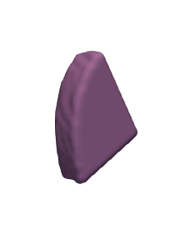
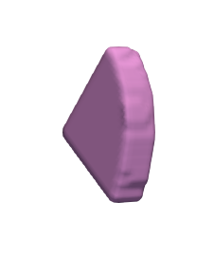
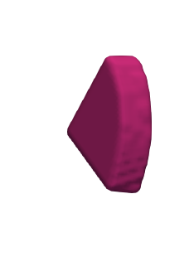
Uterus – Anterior – Fundus (#61 – 78)
ANTERIOR VIEW
PATIENT RIGHT
PATIENT LEFT
#78 Slice 3 – myometrium & endometrium
#62 Slice 1 – myometrium & endometrium
#76 Slice 2 – myometrium & endometrium
#64 Slice 2 – myometrium & endometrium
#74 Slice 1 – myometrium & endometrium
Right
Left
#77 Slice 3 – serosa & myometrium
Central
#66 Slice 3 – myometrium & endometrium
#61 Slice 1 – serosa & myometrium
#75 Slice 2 – serosa & myometrium
#63 Slice 2 – serosa & myometrium
#73 Slice 1 – serosa & myometrium
#65 Slice 3 – serosa & myometrium
#72 Slice 3 – myometrium & endometrium
#68 Slice 1 – myometrium & endometrium
#70 Slice 2 – myometrium & endometrium
#71 Slice 3 – serosa & myometrium
#67Slice 1 – serosa & myometrium
#69 Slice 2 – serosa & myometrium

Slide 7
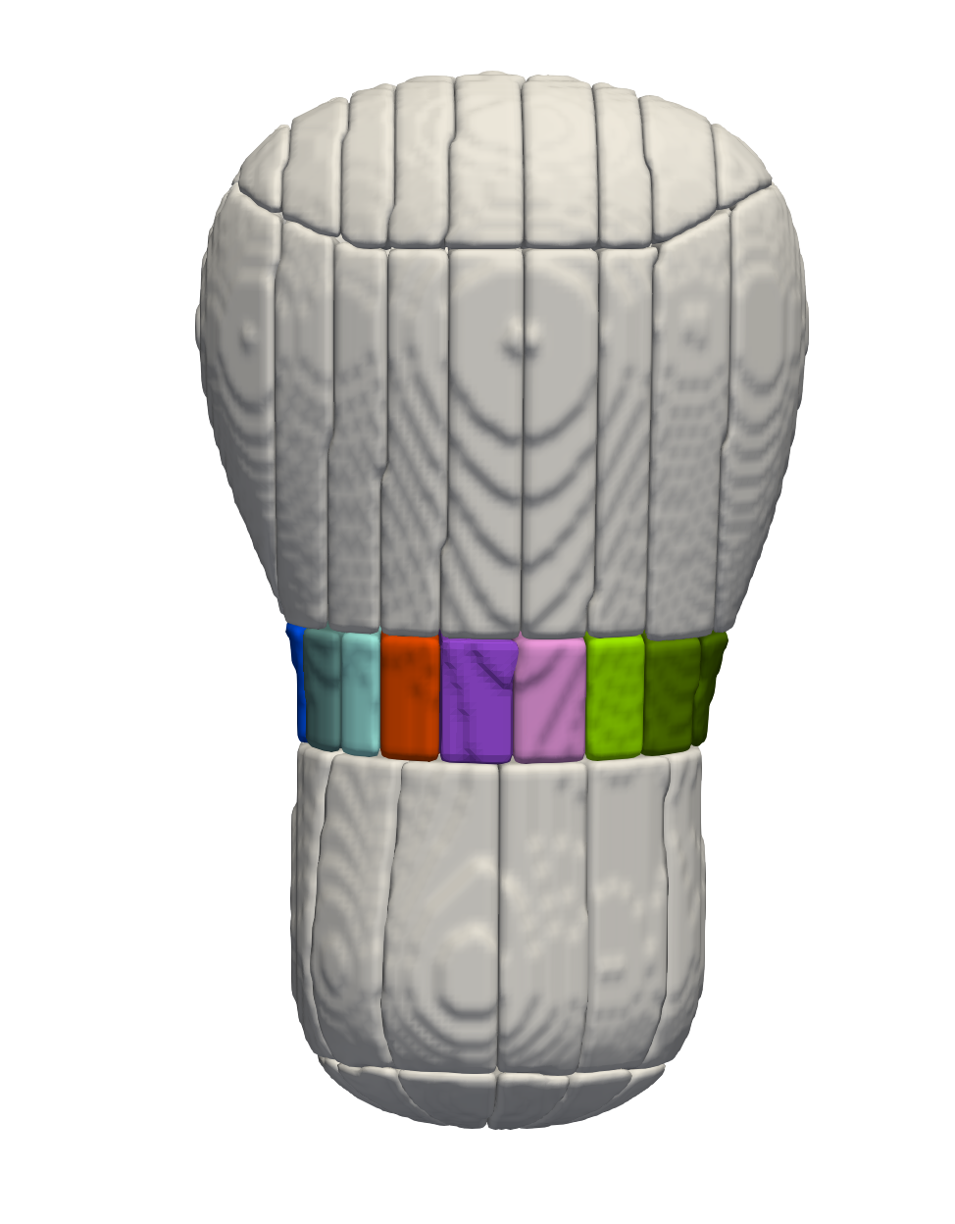
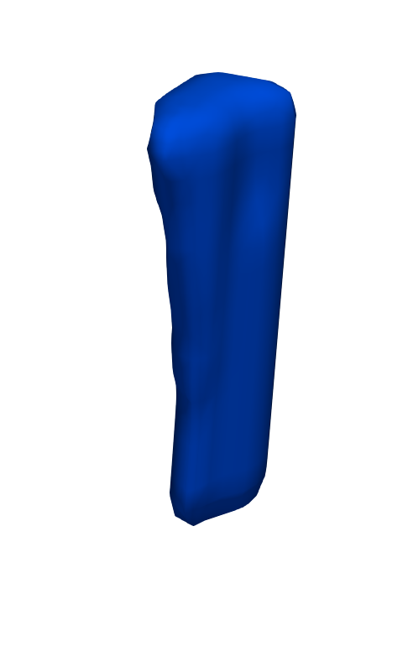
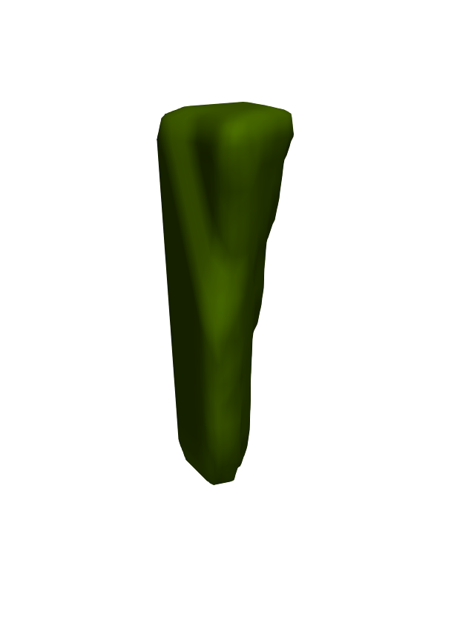
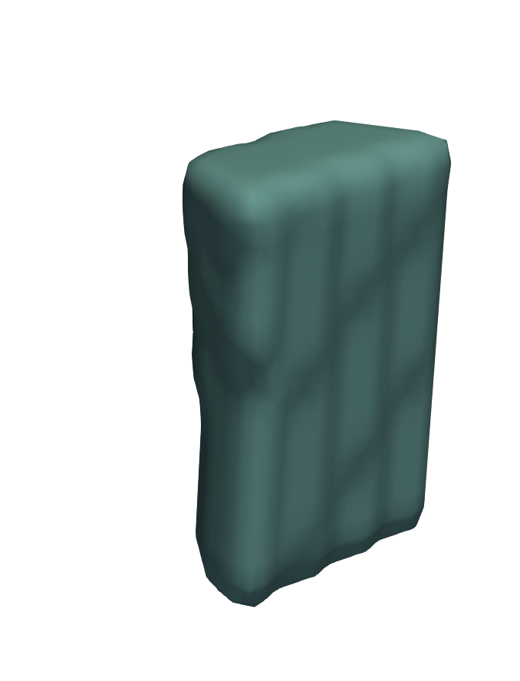
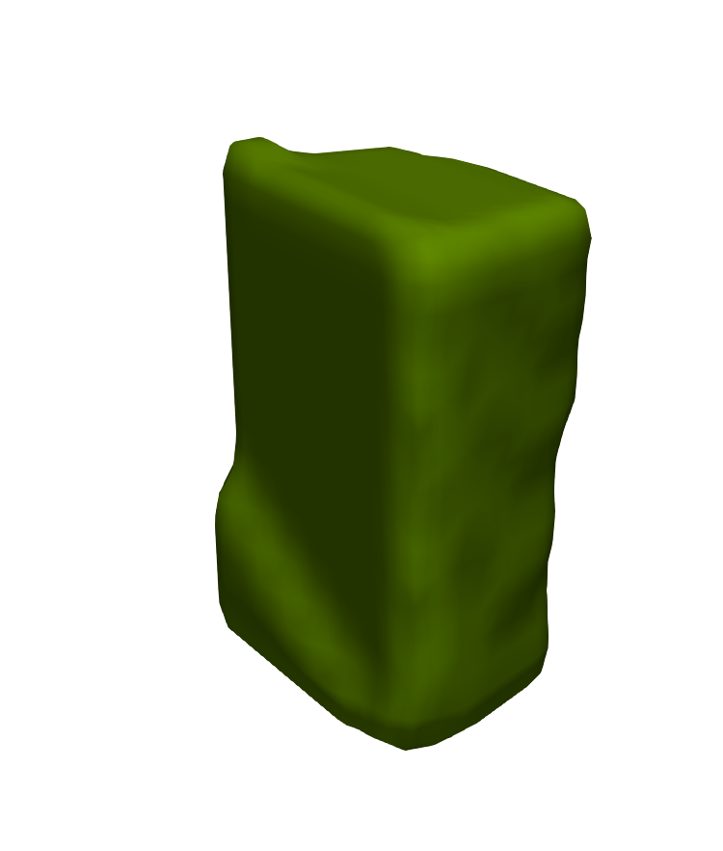
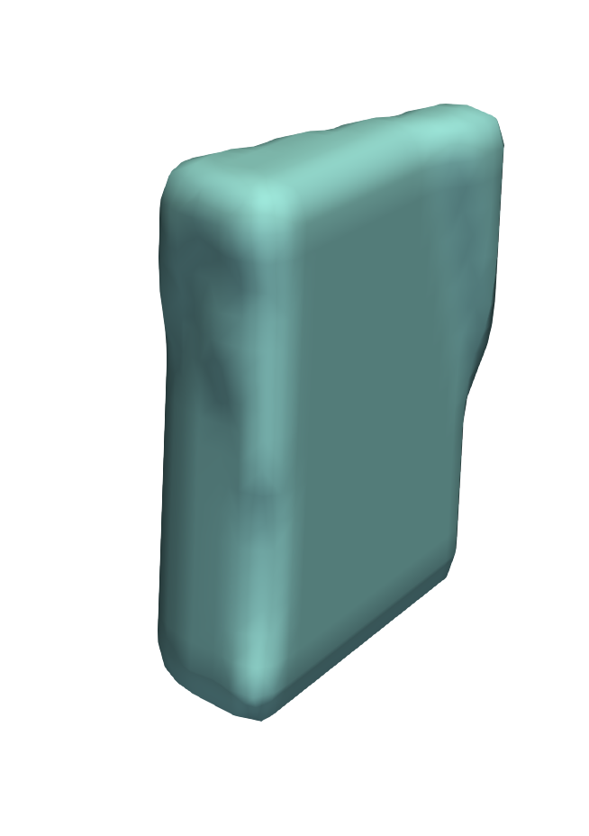

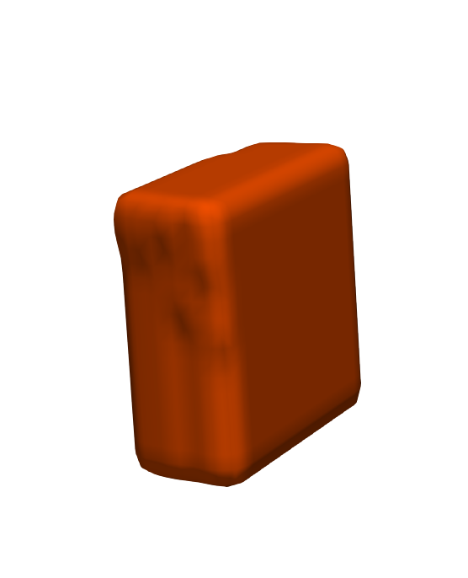
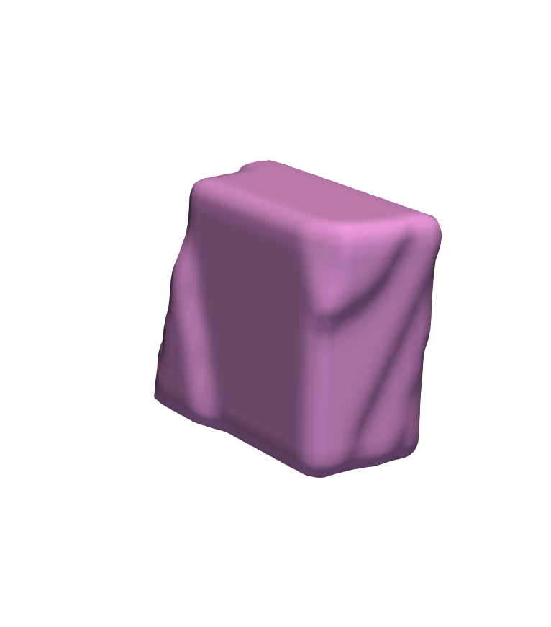

Uterus – Posterior – Lower Uterine Segment (#79 – 96)
POSTERIOR VIEW
PATIENT LEFT
PATIENT RIGHT
#80 Slice 1 – myometrium & endometrium
#96 Slice 3 – myometrium & endometrium
#82 Slice 2 – myometrium & endometrium
#94 Slice 2 – myometrium & endometrium
#79 Slice 1 – serosa & myometrium
#84 Slice 3 – myometrium & endometrium
Central
#92 Slice 1 – myometrium & endometrium
#95 Slice 3 – serosa & myometrium
Left
Right
#81 Slice 2 – serosa & myometrium
#93 Slice 2 – serosa & myometrium
#86 Slice 1 – myometrium & endometrium
#88 Slice 2 – myometrium & endometrium
#90 Slice 3 – myometrium & endometrium
#83 Slice 3 – serosa & myometrium
#91 Slice 1 – serosa & myometrium
#85 Slice 1 – serosa & myometrium
#89 Slice 3 – serosa & myometrium
#87 Slice 2 – serosa & myometrium

Slide 8
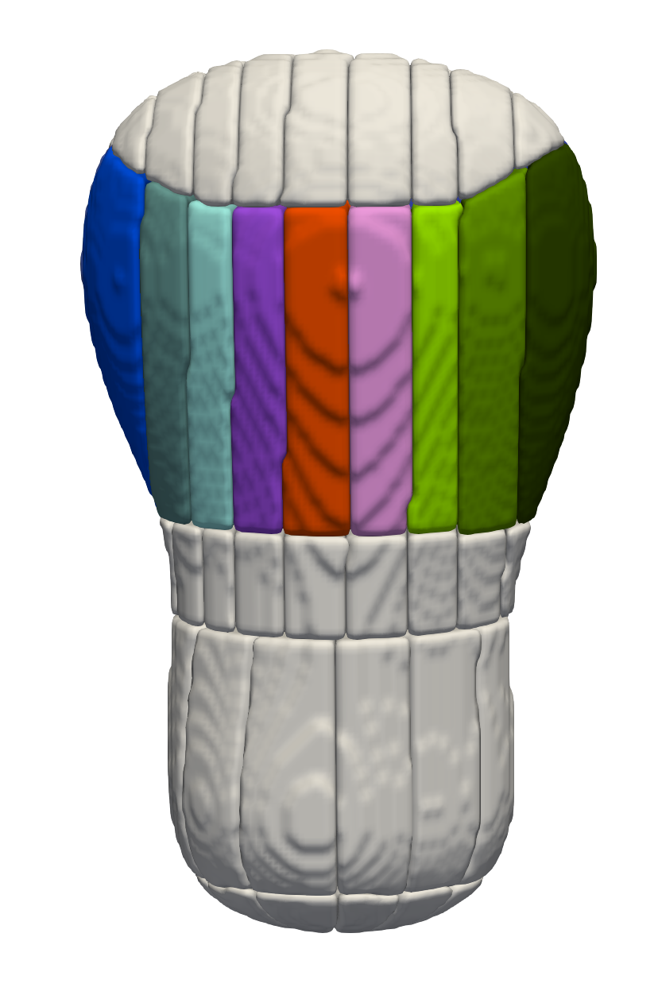
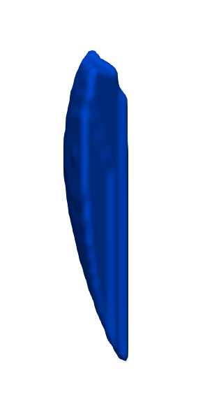
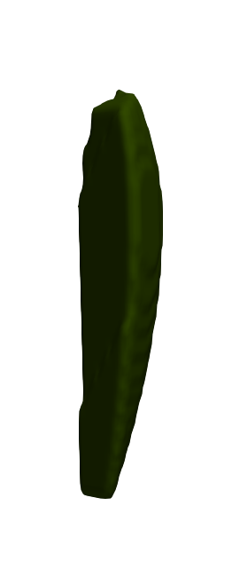
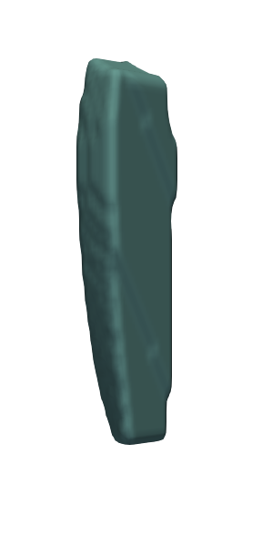
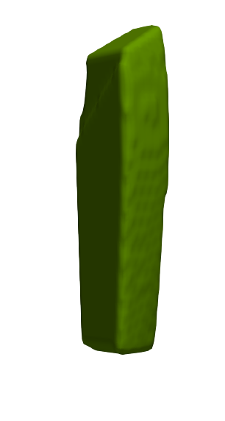
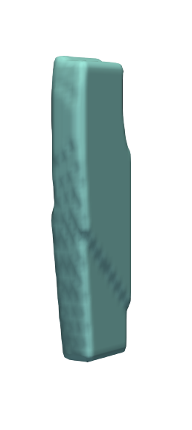
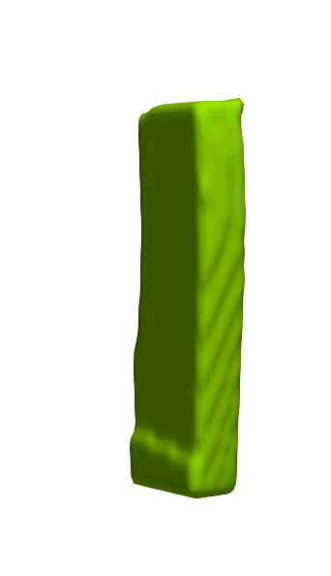
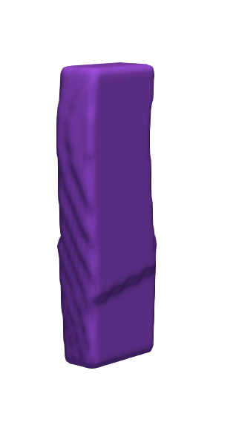


Uterus – Posterior – Body (#97 - 114)
POSTERIOR VIEW
PATIENT LEFT
PATIENT RIGHT
#98 Slice 1 – myometrium & endometrium
#114 Slice 3 – myometrium & endometrium
#100 Slice 2 – myometrium & endometrium
#112 Slice 2 – myometrium & endometrium
Central
#110 Slice 1 – myometrium & endometrium
#97 Slice 1 – serosa & myometrium
#102 Slice 3 – myometrium & endometrium
Left
Right
#113 Slice 3 – serosa & myometrium
#99 Slice 2 – serosa & myometrium
#111 Slice 2 – serosa & myometrium
#104 Slice 1 – myometrium & endometrium
#106 Slice 2 – myometrium & endometrium
#108 Slice 3 – myometrium & endometrium
#101 Slice 3 – serosa & myometrium
#109 Slice 1 – serosa & myometrium
#103 Slice 1 – serosa & myometrium
#107 Slice 3 – serosa & myometrium
#105 Slice 2 – serosa & myometrium

Slide 9










Uterus – Posterior – Fundus (#115 - 132)
POSTERIOR VIEW
PATIENT LEFT
PATIENT RIGHT
#116 Slice 1 – myometrium & endometrium
#132 Slice 3 – myometrium & endometrium
#118 Slice 2 – myometrium & endometrium
#130 Slice 2 – myometrium & endometrium
Central
Left
Right
#115 Slice 1 – serosa & myometrium
#120 Slice 3 – myometrium & endometrium
#128 Slice 1 – myometrium & endometrium
#131 Slice 3 – serosa & myometrium
#117 Slice 2 – serosa & myometrium
#129 Slice 2 – serosa & myometrium
#122 Slice 1 – myometrium & endometrium
#124 Slice 2 – myometrium & endometrium
#126 Slice 3 – myometrium & endometrium
#119 Slice 3 – serosa & myometrium
#127 Slice 1 – serosa & myometrium
#121 Slice 1 – serosa & myometrium
#125 Slice 3 – serosa & myometrium
#123 Slice 2 – serosa & myometrium

Slide 10
Fallopian Tubes

Slide 11


Fallopian Tube – Right (#1 – 12)
#5 Ampulla – Slice 2
#4 Ampulla – Slice 1
Isthmus
#3 Isthmus – Slice 3
Ampulla
#2 Isthmus – Slice 2
Infindibulum
Fimbrae
#6 Ampulla – Slice 3
#1 Isthmus – Slice 1
#12 Fimbrae – Slice 3
#11 Fimbrae – Slice 2
#7 Infindibulum – Slice 1
#10 Fimbrae – Slice 1
#8 Infindibulum – Slice 2
#9 Infindibulum – Slice 3
ANTERIOR VIEW

Slide 12
Fallopian Tube – Left (#13 – 24)
#16 Ampulla – Slice 1
#17 Ampulla – Slice 2
#14 Isthmus – Slice 2
#15 Isthmus – Slice 3
#13 Isthmus – Slice 1
#18 Ampulla – Slice 3
#24 Fimbrae – Slice 3
Isthmus
Ampulla
Infindibulum
#23 Fimbrae – Slice 2
Fimbrae
#19 Infindibulum – Slice 1
#22 Fimbrae – Slice 1
#20 Infindibulum – Slice 2
#21 Infindibulum – Slice 3
ANTERIOR VIEW

Slide 13
Ovaries

Slide 14




Right Ovary – Medial (#1-12)
ANTERIOR VIEW
#6 Slice 3 – Sup. Mes.
#5 Slice 2 – Sup. Mes.
#4 Slice 1 – Sup. Mes.
#3 Slice 3 –Sup. Antimes.
#12 Slice 3 – Inf. Mes.
#2 Slice 2 – Sup. Antimes.
#11 Slice 2 – Inf. Mes.
#1 Slice 1 – Sup. Antimes.
#10 Slice 1 – Inf. Mes.
#9 Slice 3 – Inf. Antimes.
#8 Slice 2 – Inf Antimes.
#7 Slice 1 – Inf. Antimes.

Slide 15




Right Ovary – Central (#13 – 24)
ANTERIOR VIEW
#18 Slice 3 – Sup. Mes.
#17 Slice 2 – Sup. Mes.
#16 Slice 1 – Sup. Mes.
#15 Slice 3 – Sup. Antimes.
#24 Slice 3– Inf. Mes.
#14 Slice 2 – Sup. Antimes.
#23 Slice 2 – Inf. Mes.
#13 Slice 1 – Sup. Antimes.
#22 Slice 1 – Inf. Mes.
#21 Slice 3 – Inf. Antimes.
#20 Slice 2 – Inf. Antimes.
#19 Slice 1 – Inf. Antimes.

Slide 16




Right Ovary – Lateral (#25 – 36)
ANTERIOR VIEW
#29 Slice 2 – Sup. Mes.
#28 Slice 1 – Sup. Mes.
#30 Slice 3 – Sup. Mes.
#36 Slice 3 – Inf. Mes.
#27 Slice 3 – Sup. Antimes.
#35 Slice 2 – Inf. Mes.
#26 Slice 2 – Sup. Antimes.
#34 Slice 1 – Inf. Mes.
#25 Slice 1– Sup. Antimes.
#33 Slice 3 – Inf. Antimes.
#32 Slice 2 – Inf. Antimes.
#31 Slice 1 – Inf. Antimes.

Slide 17
Left Ovary – Medial (#37 – 48)
ANTERIOR VIEW
#41 Slice 2 – Sup. Mes.
#42 Slice 3 – Sup. Mes.
#40 Slice 1 – Sup. Mes.
#46 Slice 1 – Inf. Mes.
#37 Slice 1 – Sup. Antimes.
#47 Slice 2 – Inf. Mes.
#38 Slice 2 – Sup. Antimes.
#48 Slice 3 – In. Mes.
#39 Slice 3 – Sup. Antimes.
#43 Slice 1 – Inf. Antimes.
#44 Slice 2 – Inf. Antimes.
#45 Slice 3 – Inf. Antimes.

Slide 18
Left Ovary – Central (#49 – 60)
ANTERIOR VIEW
#53 Slice 2 – Sup. Mes.
#54 Slice 3 – Sup. Mes.
#52 Slice 1 – Sup. Mes.
#58 Slice 1 – Inf. Mes.
#49 Slice 1 – Sup. Antimes.
#59 Slice 2 – Inf. Mes.
#50 Slice 2 – Sup. Antimes.
#60 Slice 3 – Inf Mes.
#51 Slice 3 – Sup. Antimes.
#55 Slice 1 – Inf. Antimes.
#56 Slice 2 – Inf. Antimes.
#57 Slice 3 – Inf. Antimes.

Slide 19
Left Ovary – Lateral (#61 – 72)
ANTERIOR VIEW
#64 Slice 1 – Sup. Mes.
#65 Slice 2 – Sup. Mes.
#66 Slice 3 – Sup. Mes.
#61 Slice 1 – Sup. Antimes.
#70 Slice 1 – Inf. Mes.
#62 Slice 2 – Sup. Antimes.
#71 Slice 2 – Inf. Mes.
#63 Slice 3 – Sup Antimes.
#72 Slice 3 – Inf. Mes.
#67 Slice 1 – Inf. Antimes.
#68 Slice 2 – Inf. Antimes.
#69 Slice 3 – Inf. Antimes.

